Slide 1
Luhn's algorithm
The fascinating world of check digits

Slide 2
Overview
What is a checksum
More about Luhn
Example: Checksum calculation of credit cards

Slide 3
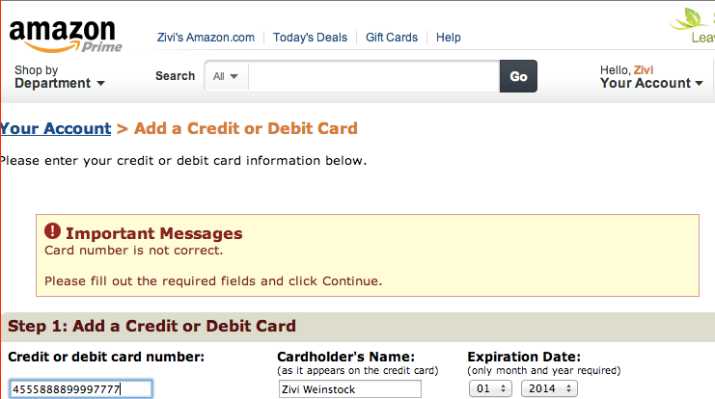
Has this ever happened to you?

Slide 4
Example of the Amex checksum process:
Sample credit card number: 3852 00000 23237
Double every second digit from the second to last: 31654000004343
Sum all the individual digits: 3+1+6+5+4+0+0+0+0+0+4+3+4+3 = 33
Multiply the result by 9: 33 * 9 = 297
Mod 10 the result: 297 % 10 = 7
Number matches the check digit

Slide 5
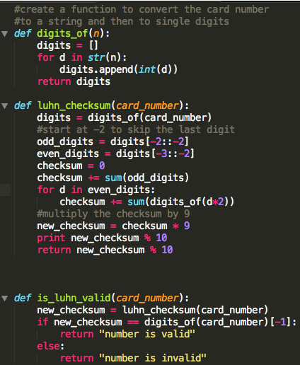
Checksum code
Checksum code

Slide 6
Pros and Cons of Luhn algorithm
Pros
Catches single digit errors.
Spots simplistic fraud.
Cons
May miss:
Transposition (swapping digits).
Multi-digit errors.

Slide 7
Thank you
Further reading:
1. More checksum formulas:
http://www.ee.unb.ca/tervo/ee4253/luhn.shtml
2. What your credit card numbers mean:
http://www.computersolving.com/computer-tips-tricks/what-your-credit-card-numbers-mean/

